Slide 1

Motion Planning
RBE 550
Spring 2021
Autonomous exploration using RRT-SLAM
Project Report
Aditya Jagani
Ali Abdelhamid
Rohan Walia
Notes:
Hello Everyone,
My name is Ali and this semester I had the pleasure of working with Aditya and Rohan on an autonomous exploration application using an RRT-SLAM algorithm. A fully autonomous robot is capable of exploring its environment with the correct implementation and integration of path planning, perception, and control modules.

Slide 2
Recap: Research Problem
The process of mapping is done manually by humans and can often take lot of time, especially for large areas
Mapping areas with hazardous or dangerous occupants (mining)
Motion planning algorithms enable mobile robots to efficiently explore unknown environments and construct maps by incurring minimum costs
Environments have irregular geological structures with unpredictable topologies stretching for long distances making it a challenge to navigate through and explore complex and diverse terrains
Notes:
Even though the versatility of human motion and planning makes us extremely capable of exploring unknown and irregular terrain, many exploration tasks remain extremely difficult or dangerous for humans to do. In cases such as cleaning out nuclear waste or exploring vast areas: the exploration task becomes increasingly costly and tedious for a human. This brings a need for mobile robots that are also self guided and can be left to complete the exploration task and return results.

Slide 3
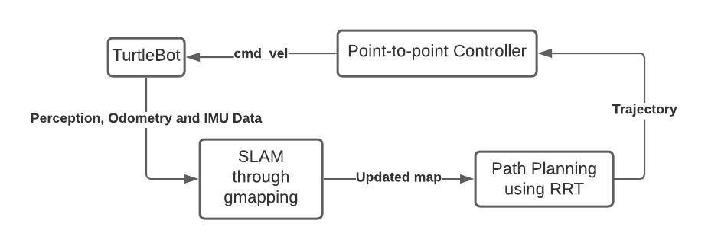
Overall Approach
RRT-SLAM technique can be simulated by leveraging the ROS framework on the Kobuki Turtlebot
Notes:
The exploration task for the mobile robot was made up of the following:
-An open source turtlebot simulation package publishing location and LIDAR perception data to ROS topics
-A SLAM algorithm which takes location and perception information from the Turtlebot and updates the map of the robot with both new C-free or any new obstacles in that space. This updated map is iteratively passed on to the path planning module
-This path planning module is an RRT implementation. This RRT receives a map from the SLAM algorithm in the form of a 2D configuration space populated with free and obstacle nodes. The RRT algorithm then uses obstacle detection and collision avoidance methods to create a tree of possible paths throughout C-free. This implementation of RRT also incorporates a task allocator which selects which node in the tree the robot should move towards
-The task allocator passes best node decisions to the robot controller which moves the robot.
Once the robot moves, the map is updated, and the loop goes on.

Slide 4
RRT – Advantages, Drawbacks and Improvements ^{[1]}
Advantages – Ensures maximum area coverage
Prefers unvisited and unexplored regions
Is complete
Sampling based (low compute cost)
Drawbacks
May induce overlapping – costs time and effort
Not necessarily optimal solution
Improvements
Filtering frontier nodes
Simultaneous, asynchronous tree updating
Notes:
The advantages of RRT are a preference to unvisited and unexplored regions, a complete solution if one exists, and a sampling based structure which ensures a low compute cost.
The disadvantages of RRT is that it may induce overlapping and mainly that the solution is not always an optimal solution. In fact, the computing cost increases exponentially as the the RRT solution approaches the optimal solution given that the tree will be required to include nodes covering the entire space, negating the sampling based nature of the system.
To enhance the robot exploration capabilities and further maintain computing costs, we also added methods for filtering frontier nodes and simultaneously updating of the tree based on new map input

Slide 5
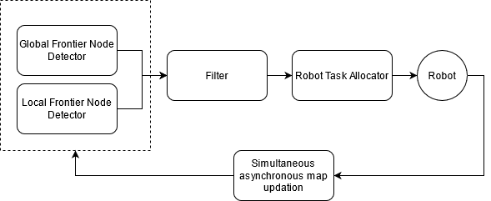
Modified RRT Exploration Implementation^{[1]}
Notes:
Expanding on our modification to the RRT implementation, we equipped the algorithm with the following:
A Global frontier node detector: which keeps track of frontier nodes throughout the explored area.
Local frontier node detector: which explores frontier nodes in the immediate vicinity of the robot and resets whenever a new node is added.
A Filter: which reduces number of frontier nodes by selecting the center of clusters of all available frontier nodes. This also helps in removing old frontier nodes (which are no longer in the unexplored region), and invalid frontier nodes (which cannot be reached by the robot)
A Robot task allocator: which uses a cost-benefit analysis to assign frontier points to the robot.

Slide 6
Task Allocation
Task allocation: Selects best frontier node based on Navigation cost and Information Gain
Navigation Cost: Distance between current position and frontier position
Information Gain: Measure of unexplored area within a certain radius of the candidate frontier node
Revenue: Net gain associated with a frontier node, calculated using Navigation cost and Information Gain.
Notes:
The robot task allocator decides which nodes to pass on to the controller for the robot to start moving towards. This node selection was based on navigation cost, information gain, and revenue

Slide 7
Calculations: Information Gain and Revenue
Information Gain:
I(x_{fp}) = n_{cells} * a_{cell}
Revenue:
R(x_{fp}) = λ * h(x_{fp}, x_{r}) * I(x_{fp}) - N(x_{fp})
Hysteresis:
h(x_{fp}, x_{r}) = 1 IF ||x_{r} – x_{fp}||> h_{rad} OR h(xfp, xr) = h_{gain} where h_{gain} > 1
Notes:
The information gain radius is set by the user, and should ideally be equal to the preception sensor range.
Information gain constants – x_fp: frontier point , n_cells: number of cells in the specified information gain radius, a_cell: area of each cell
Revenue constants: λ: Information gain weight (defined by the user) - used to balance information gain and navigation cost in calculating the revenue, xr: current robot position, h: hysteresis gain, I: Information gain, N: Navigation cost
Hysterisis gain: Dictates how well a robot is motivated to favor unexplored environments. A higher hysteresis gain would encourage the robot to explore frontier nodes in it's vicinity, which would reduce the chances of overlapping.
H_gain:

Slide 8
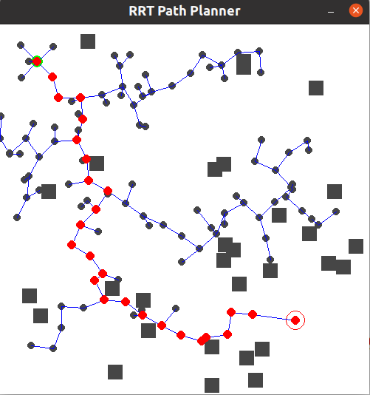
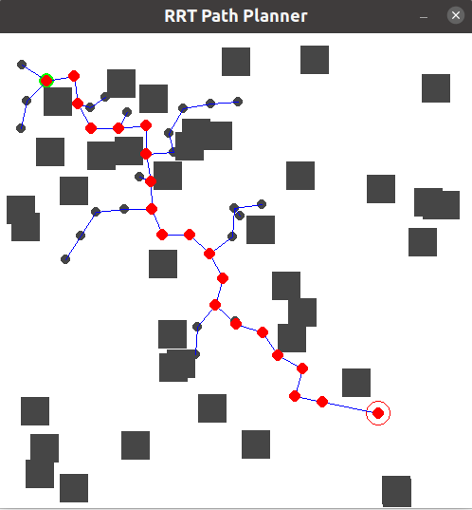
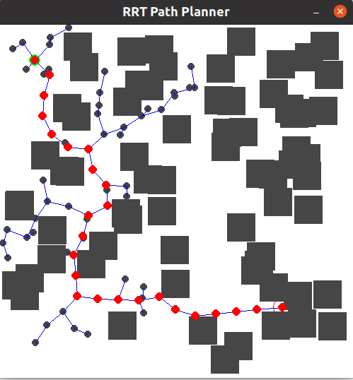
RRT Implementation (Proof of concept)
PyGame module used for visualization
Obstacles added manually
Notes:
RRT Path Planner Implemented in Python, using PyGame for visualization. The workspace and obstacles were user generated but replaced with input from the simulation environment. Figures shown below (left to right) are in order of increasing obstacle number and size. Note that the start and goal nodes are identical for all figures.
The tree is shown in blue, while the path taken is highlighted in red.

Slide 9
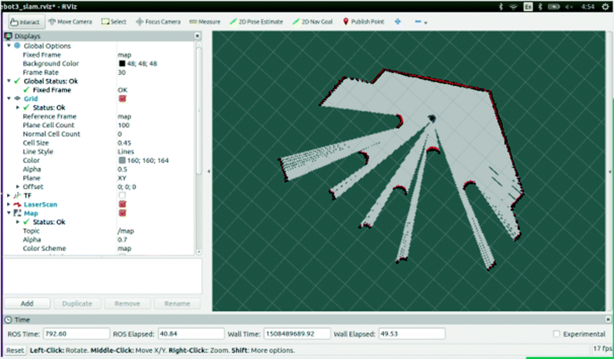
SLAM Implementation
GMapping Slam Module implemented in RViZ using Teleop
Notes:
The Gmapping package was successfully able to map the environment, however its particle cloud dispersed widely when the features in its vicinity decreased.
Another method we implemented was the Hector SLAM. Initially, it worked quite well. The robot was able to localize quite quickly, however, after increasing its speed, the map was distorted. We can imply that the robot was unable to localize and therefore lost its sense of position and orientation.

Slide 10
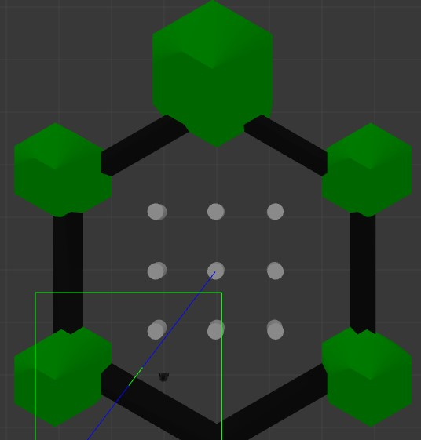
Map 1

Slide 11
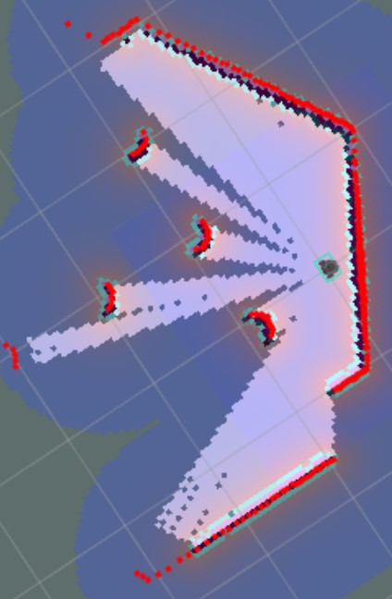
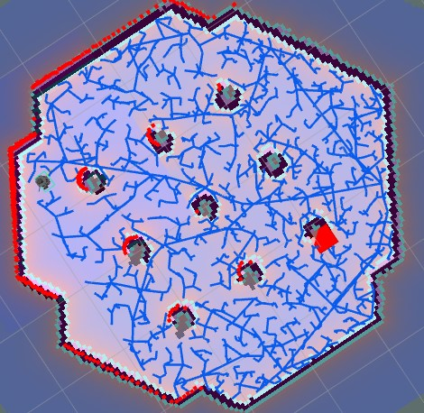
Simulation Results: Map 1
Notes:
The first map is relatively simple to explore partly due to its symmetric nature.

Slide 12
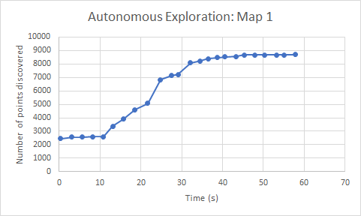
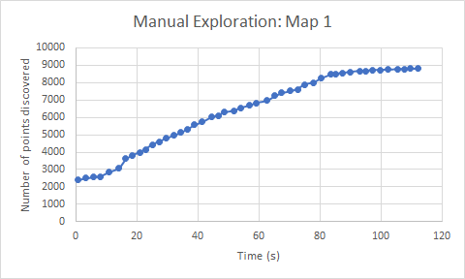
Map 1: Comparison
Notes:
We see that autonomous exploration performs slightly better than manual exploration, but the performance can be considered comparable.

Slide 13
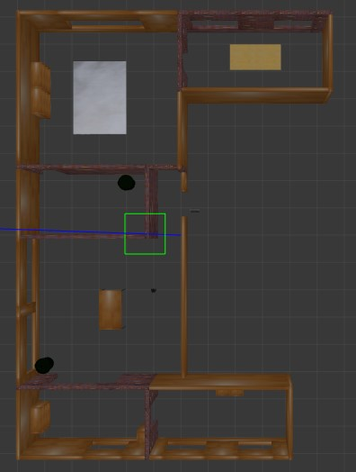
Map 2
Notes:
The second map that we used for testing our algorithm was a bigger one where we wanted it to explore the room it was in. The simulation environment is an office environment with several features such as walls, tables, chairs, trash cans, etc.

Slide 14
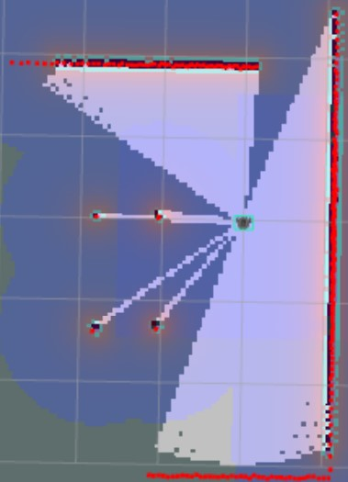
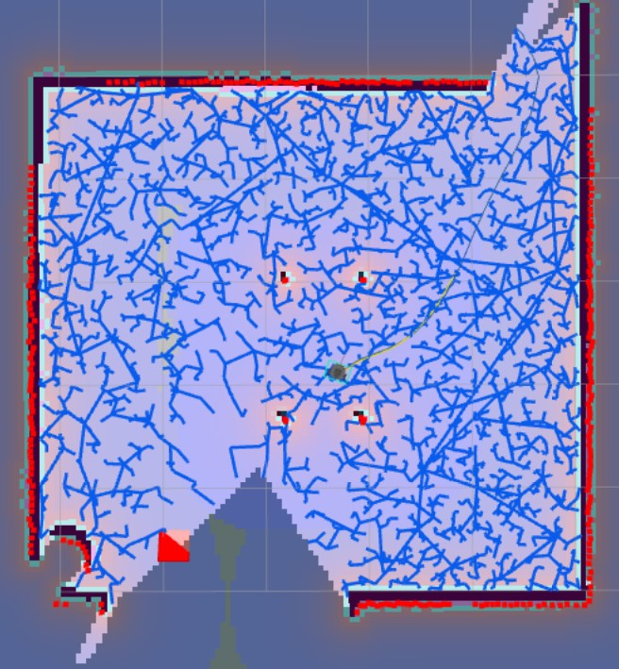
Simulation Results: Map 2
Notes:
The image on the left is of the robot creating a map at time t = t0
Whereas the image of the right is that after exploring the region
On observing the map, we can see that a slight portion is not yet explored, however we can see a frontier node being detected,
And eventually that area would be explored too.

Slide 15
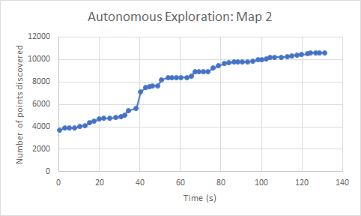
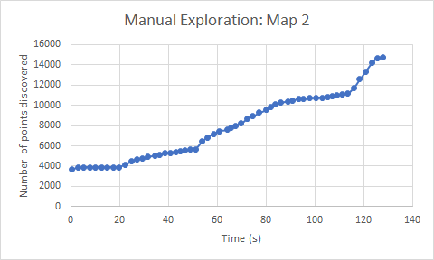
Map 2: Comparison
Notes:
Comparing autonomous exploration between robot and man, we can say that these results are very comparable. Although in graph it might seem that the manually exploring supersedes autonomous exploration, however during mapping the user had birds-eye view of the whole map which acted as a bias. In real-life applications, that might not be the case and we believe that autonomous exploration would rather be more efficient and useful.

Slide 16
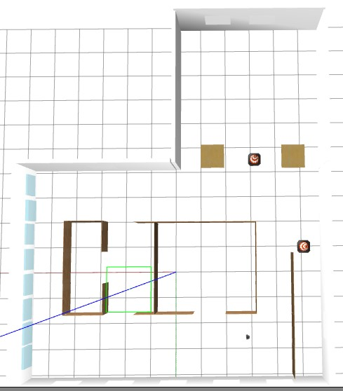
Map 3
Notes:
Next, we tried our algorithm on an even bigger map, wherein we asked the robot to explore the whole map as shown here.

Slide 17
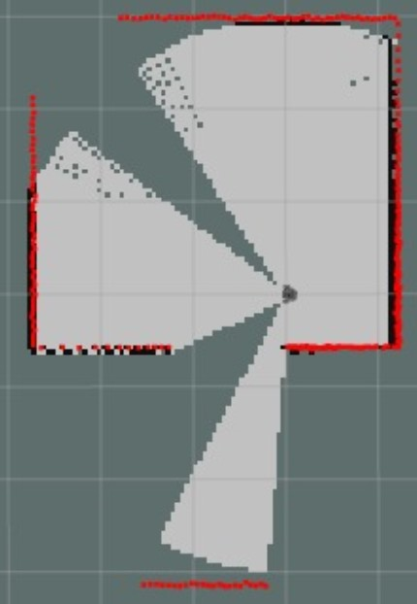
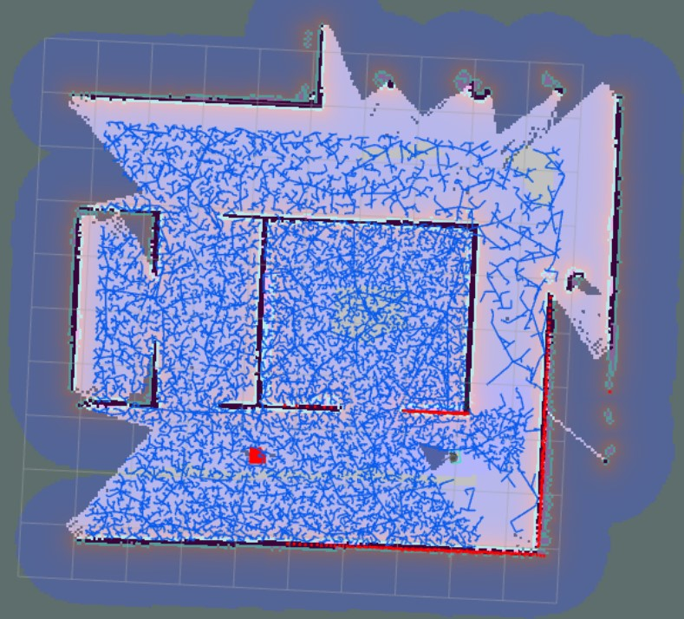
Simulation Results: Map 3
Notes:
The left image represents map at time at t = to
After a particular amount of time, the robot was successfully able to build a map of the whole environment and it did so spectacularly.

Slide 18
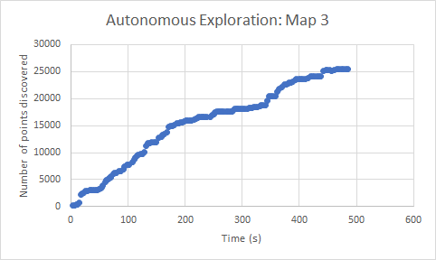
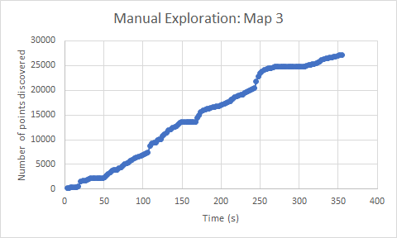
Map 3: Comparison
Notes:
We can see the information gain in this graph and several points is comparable to manual exploration.

Slide 19
Conclusion and Future Work
Manual exploration is comparable to autonomous exploration
Multiple robot exploration should be implemented [1]
A better metric to choose local frontier nodes should be used [2]
Notes:
Based on the comparison of autonomous and the manual exploration of the three different maps, it can be said that autonomous exploration is comparable to manual exploration (maps 2 and 3), and sometimes better (map 1). However, it should be considered that manual exploration has the added advantage of the birds-eye view being available to the user in simulation and adds a certain level of bias. However, for autonomous exploration in real-world, the robot does not have the map beforehand nor has the user prior knowledge of the map. Therefore, in real-world applications such as in mining, autonomous exploration is hugely helpful in determining the structure underneath. It also has the added advantage of being independent of any form of communication from the user, hence if a robot is left to its own it can autonomously explore the region without any external commands.
The current software utility allows for single robot control. In future, multiple robots can be deployed, each building and updating its own local RRT, while another robot/communication server keeps track of the global map.
Research [2] shows that hysteresis gain is not the best metric to enforce the robot to choose the closest frontier points. A better metric might be used to improve this behavior.

Slide 20
References
[1] H. Umari and S. Mukhopadhyay, "Autonomous robotic exploration based on multiple rapidly-exploring randomized trees," 2017 IEEE/RSJ International Conference on Intelligent Robots and Systems (IROS), 2017, pp. 1396-1402, doi: 10.1109/IROS.2017.8202319.
[2] R. Simmons, D. Apfelbaum, W. Burgard, D. Fox, M. Moors, S. Thrun, and H. Younes, “Coordination for multi-robot exploration and mapping,” in Proceedings of the AAAI National Conference on Artificial Intelligence, Austin, TX, 2000, pp. 852–858.

